Slide 1

MINI PROJECT
EVALUATION OF
ACADEMIC PERFORMANCE
Mentor - Dr Aditya Pai H, Associate Professor, Department of Computer Science
Presented by - Manvi Haritwal 2018926(40) 3rd Sem CSE-B

Slide 2

INTRODUCTION
The project titled ‘EVALUATION OF ACADEMIC PERFORMANCE’ is a Python GUI-based application developed to manage and view the academic performance/results of the students.
This project contains three modules - Login, Admin and Student. Login module is used to login into the application based on the roles. Admin module is used to create and manage student details, course details, subject details and results. Student module allows the user to only view their results.
Registered Users can login and access the database according to their roles

Slide 3

PROBLEM STATEMENT
01
02
03
All the work is done manually which means time consuming and high risks of errors
It is difficults to manage and access the data of thousands of students
System is less secure and data is difficult to backup. It also requires more and more paperwork to be done.

Slide 4
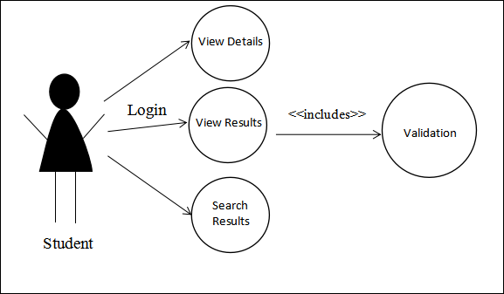
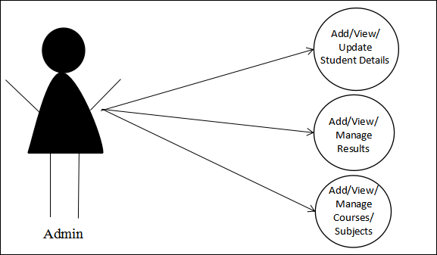
METHODOLOGY
STUDENT MODULE
ADMIN MODULE
Student can view their results
Admin can add and manage student details, course details, subject details and results.

Slide 5
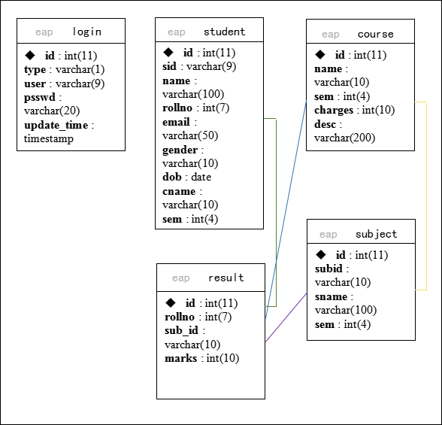
D
A
T
A
B
A
S
E
D
I
A
G
R
A
M

Slide 6
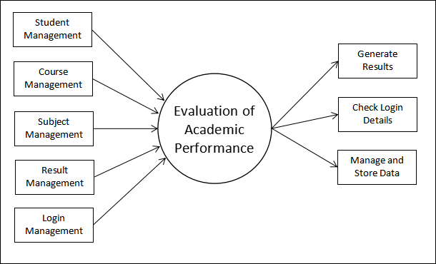
D
A
T
A
F
L
O
W
D
I
A
G
R
A
M

Slide 7
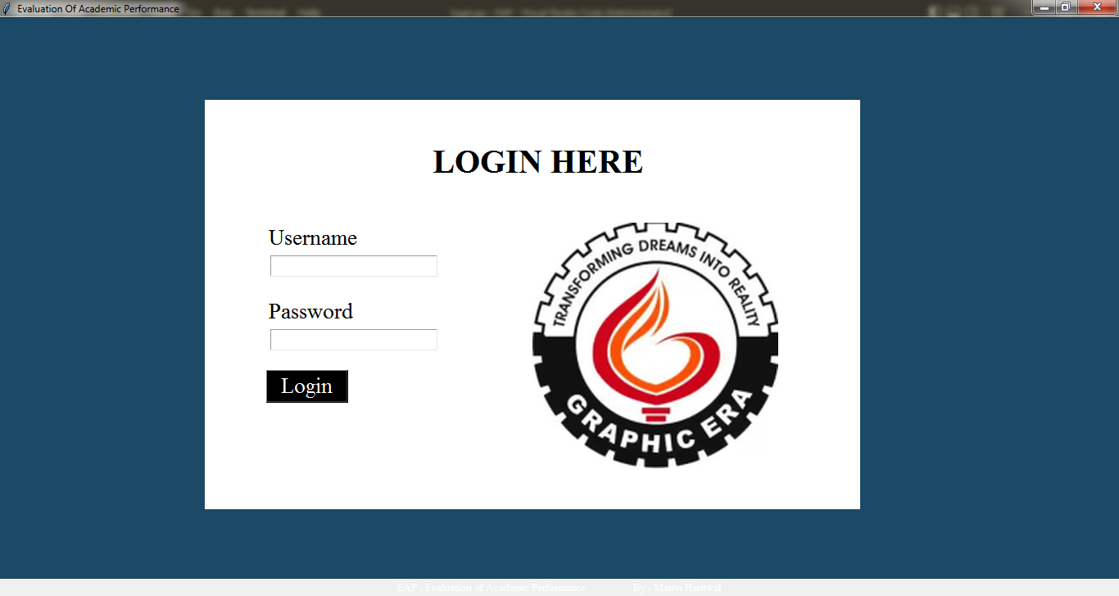

Slide 8
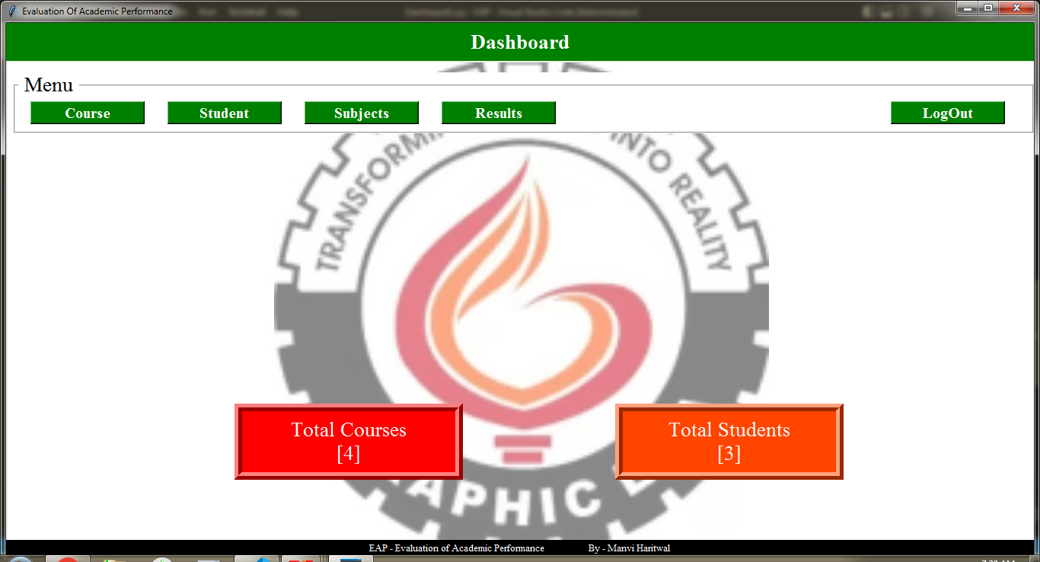

Slide 9
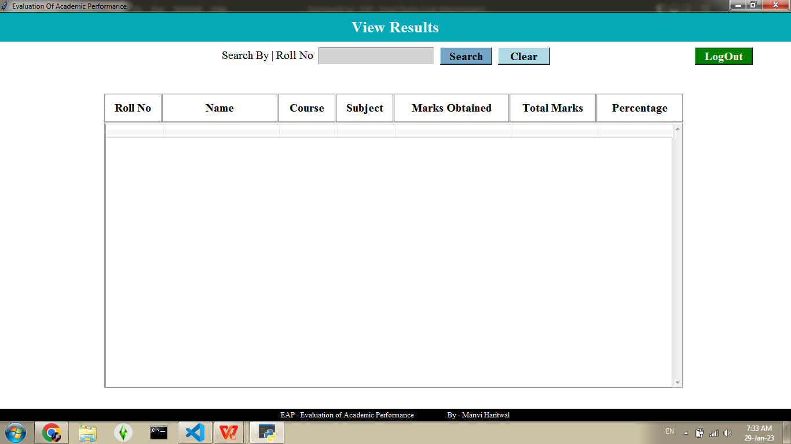

Slide 10

CONCLUSION
The project simplified the tasks of evaluators because they do not need to perform the complicated and time-consuming operation, compared to the current existing traditional method practices. Ultimately, the proposed system is designed specifically to ensure fairness and transparency during the evaluation of student performance. Thus, the objective of this study, which is to reduce risks of traditional system and to reduce time consumption is achieved. The development of this project was proven to assist evaluators in providing an improved decision-making solution to the evaluators during the evaluation process.
01
FUTURE WORK
02
In near future, the system interface could be improved, with more attractive, interactive and meaningful images; with an email and SMS or email notifications. Or Enhancing the current system by computerizing almost all the services provided by the institution, turning it into a complete Student Management System. And evolve the system by developing several versions through users feedback if a complete solution has not been worked out.

Slide 11
MINI PROJECT
THANK YOU!

